Slide 1
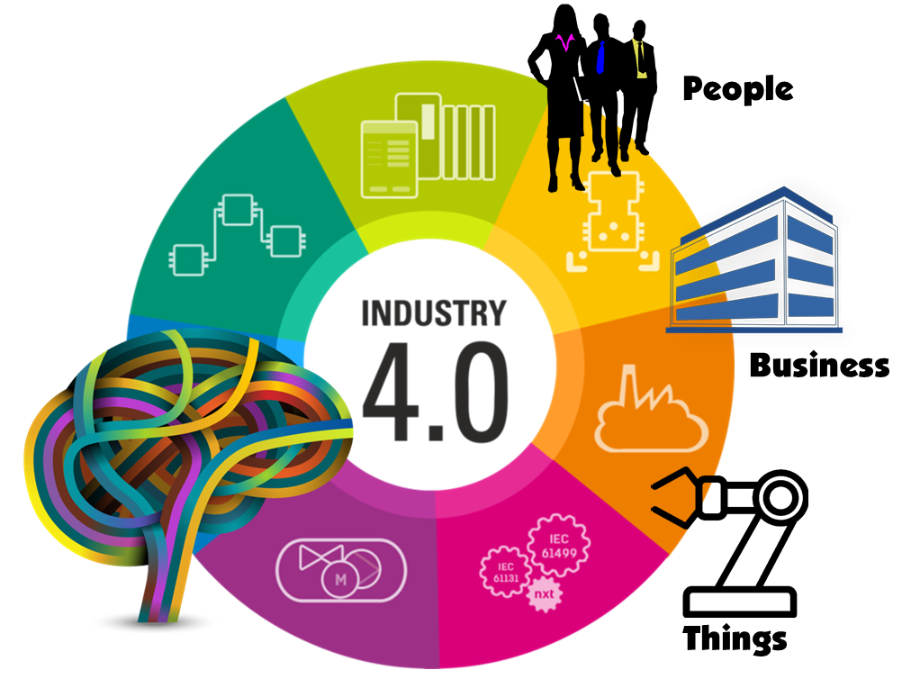
I
N
D
U
S
T
R
I
E
4.0
INDUSTRY 4.0

Slide 2
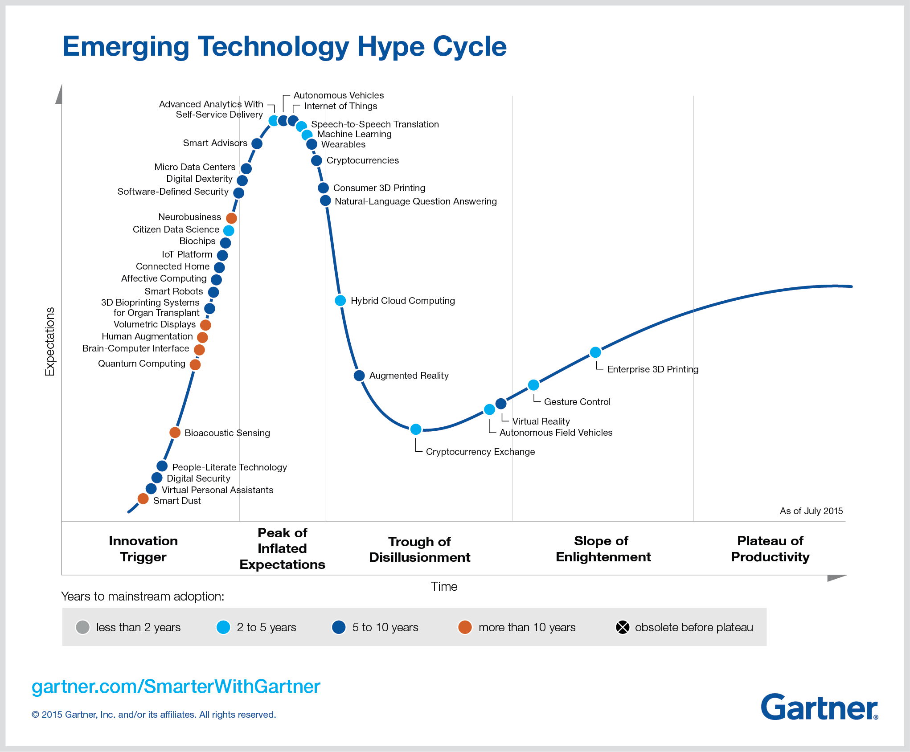

Slide 3
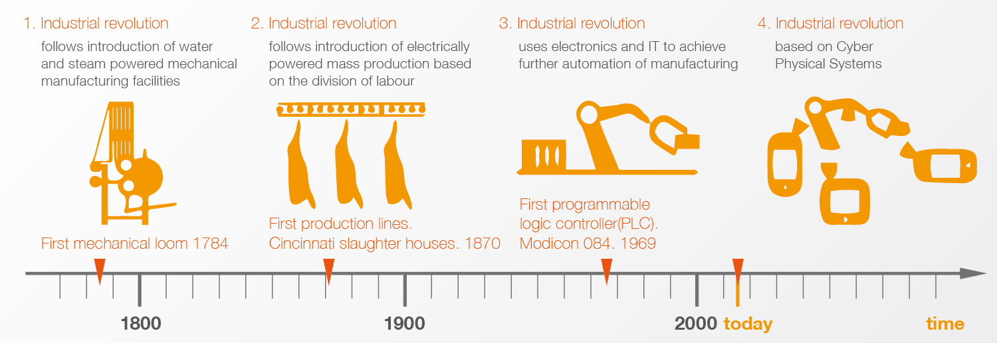

Major trends in industrial evolution
“Industry 4.0 is more than just a flashy catchphrase. A confluence of trends and technologies promises to reshape the way things are made.”

Slide 4



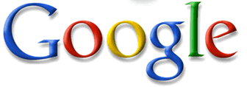


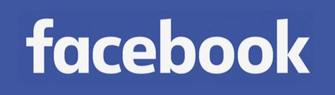


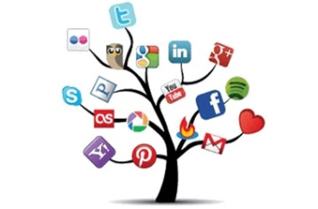
The Impact of Information and Communication Technology
Hypermedia: Interlinked Documents
Cyber-Physical Media: Interlinked Systems
Multimedia: Interlinked Media
Social media (1): Interlinked People
Social media (2): Interlinked Enterprises
Web
World Wide Web
Web 1.0
Java, UML, XML
Web 2.0
Web Services
Web 3.0
App Technologies
Web A.B
IoT, IoS, IoP

Slide 5
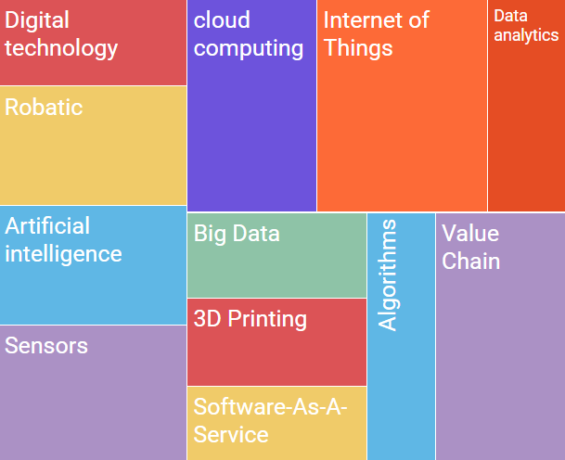

The term Industry 4.0 refers to the combination of several major innovations in digital technology, all coming to maturity right now, all poised to transform the energy and manufacturing sectors. These technologies include advanced robotics and artificial intelligence; sophisticated sensors; cloud computing; the Internet of Things; data capture and analytics; digital fabrication (including 3D printing); software-as-a-service and other new marketing models; smartphones and other mobile devices; platforms that use algorithms to direct motor vehicles (including navigation tools, ride-sharing apps, delivery and ride services, and autonomous vehicles); and the embedding of all these elements in an interoperable global value chain, shared by many companies from many countries.

Slide 6







Industry 4.0 Workgroups
Co-chair
Henning Kagermann
Co-chair
Siegfried Dais
WG 1 – The Smart Factory:
Manfred Wittenstein
WG 2 – The Real Environment:
Siegfried Russwurm
WG 3 – The Economic Environment:
Stephan Fischer
WG 4 – Human Beings and Work:
Wolfgang Wahlster
WG 5 – The Technology Factor:
Heinz Derenbach
The Industry 4.0 workgroup members are recognized as the founding fathers and driving force behind Industry 4.0.

Slide 7

How German is industry 4.0?

Slide 8
Design Principles
Internet of Things (IoT)
Internet of People (IoP)
Digital plant models
virtual copy of the physical world
Industry 4.0
Interoperability
Information transparency
Technical assistance
Decentralized decisions
The ability of cyber physical systems to physically support humans by conducting a range of tasks.
The ability of cyber physical systems to make decisions on their own and to perform their tasks as autonomous as possible.

Slide 9
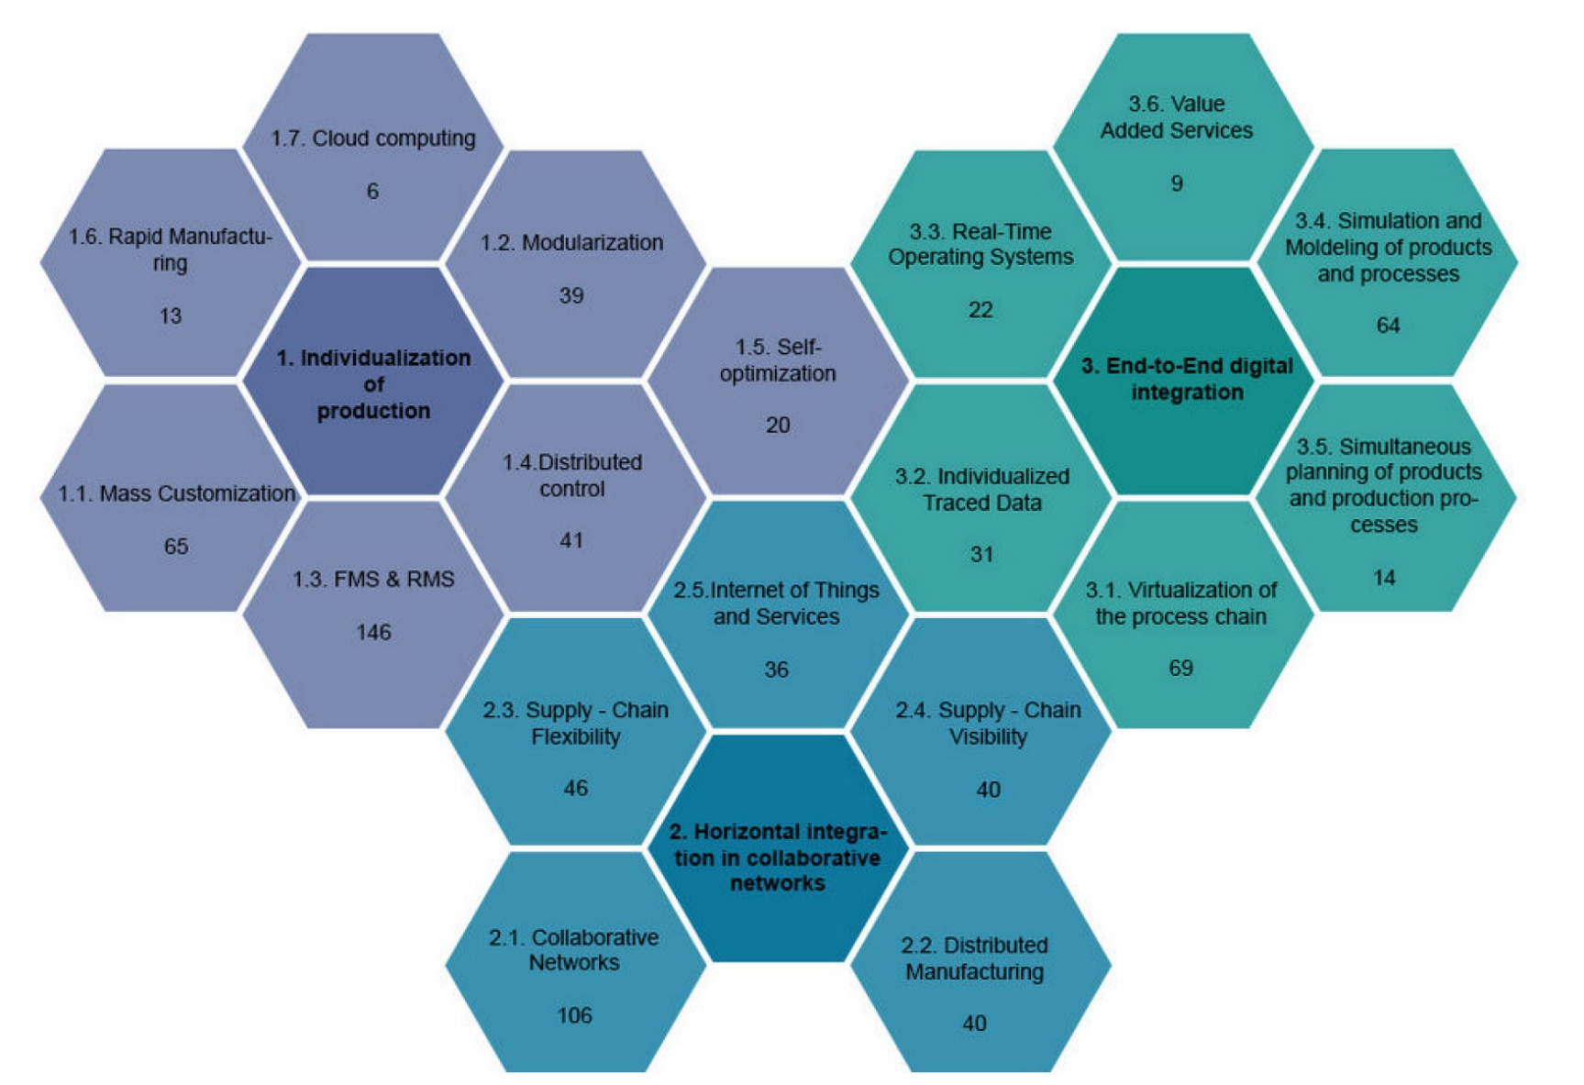
Industry 4.0 related research streams
The numbers underneath the topics illustrate the assigned articles.
Source: Brettel, M., Friederichsen, N., Keller, M., & Rosenberg, M. (2014). How virtualization, decentralization and network building change the manufacturing landscape: An industry 4.0 perspective. International Journal of Mechanical, Industrial Science and Engineering, 8(1), 37-44.

Slide 10
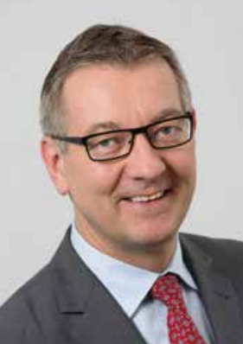

The essence of the Industry 4.0 vision, the “Internet of Things”, is the ubiquitous connection of people, things and machines. This connection is intended to produce a variety of new goods and services.
Products, means of transport or tools are expected to “negotiate” within a virtual marketplace regarding which production elements could best accomplish the next production step. This would create a seamless link between the virtual world and the physical objects within the real world.
Examples of factories in which the production processes are digitally supported throughout already exist – however, these processes still have a low level of complexity. A “digital company” with a continuous digital value chain not only digitally integrates the shop floor, but also the development and sales departments from the office floor.
Prof Dr-Ing Dieter Wegener
Siemens AG, Digital Factory Division,
“Industry 4.0” Coordinator

Slide 11
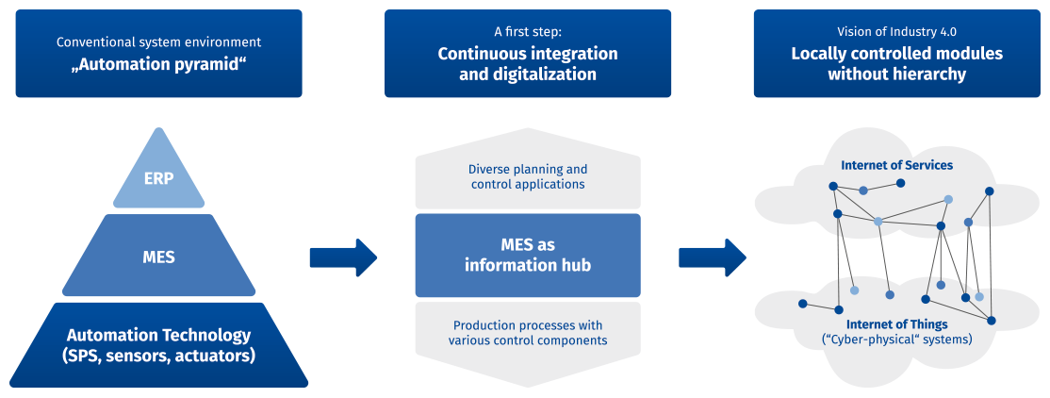
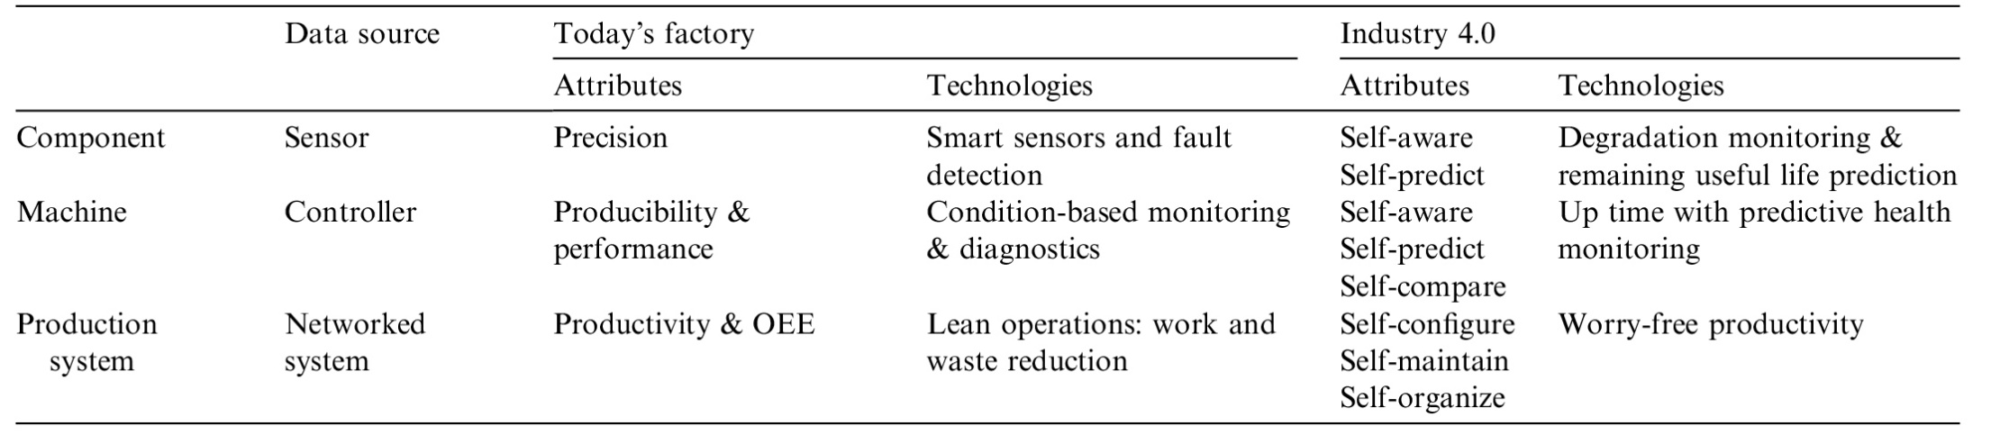
Today’s factory VS. Industry 4.0
Source: Lee, J., Bagheri, B., & Kao, H. A. (2015). A cyber-physical systems architecture for industry 4.0-based manufacturing systems. Manufacturing Letters, 3, 18-23.

Slide 12
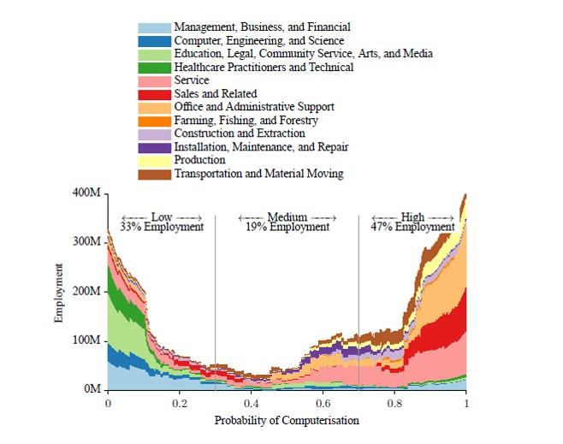
Quantitative repercussions on the number of employees
47% of Americans have a high risk of further digitalization and automation of their workplace.
The impact on employees is not jet quantifiable. Some see the digitalization as part of the future job market, others fear the loss of jobs.

Slide 13
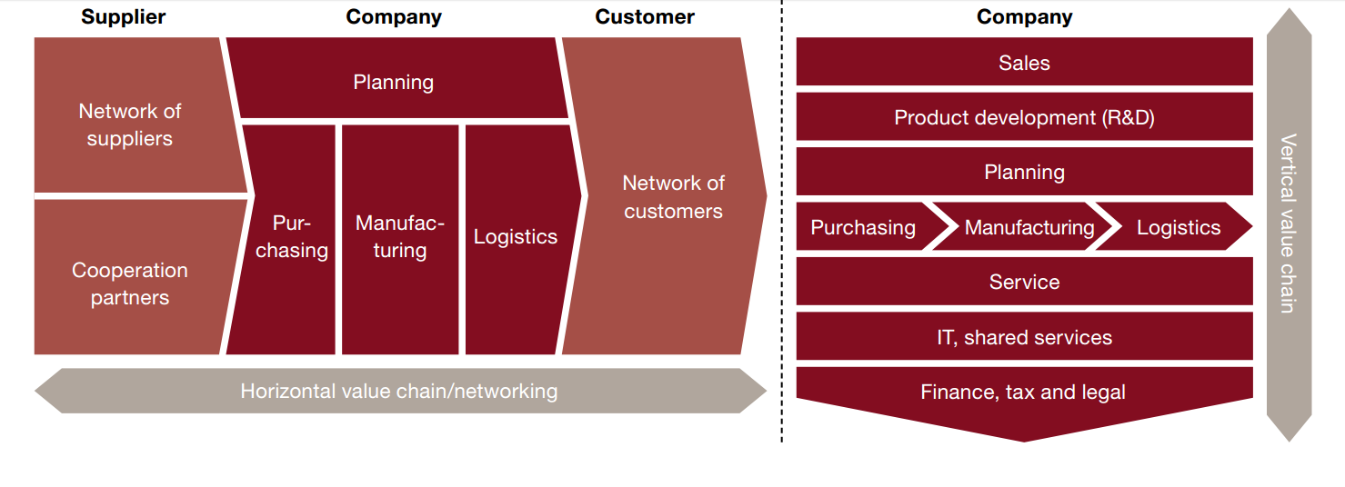
Industry 4.0 requires comprehensive digitization of the horizontal and vertical value chains
Some of improvements may result from the digitization of processes and value chains:
Focusing on core areas in the individual value chain • Reduction of redundancies in processes
Minimizing quality losses
Making processes more flexible and coherent

Slide 14
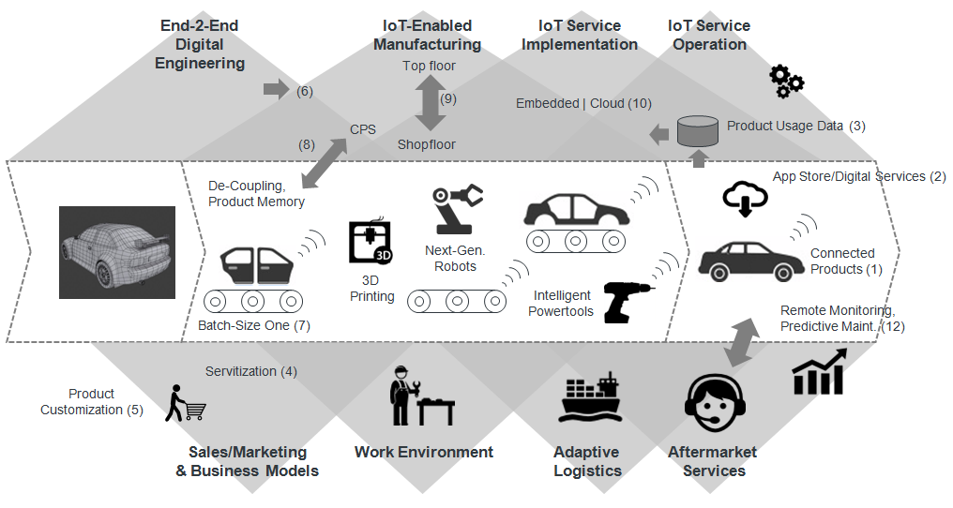
Industry 4.0: Value Chain

Slide 15
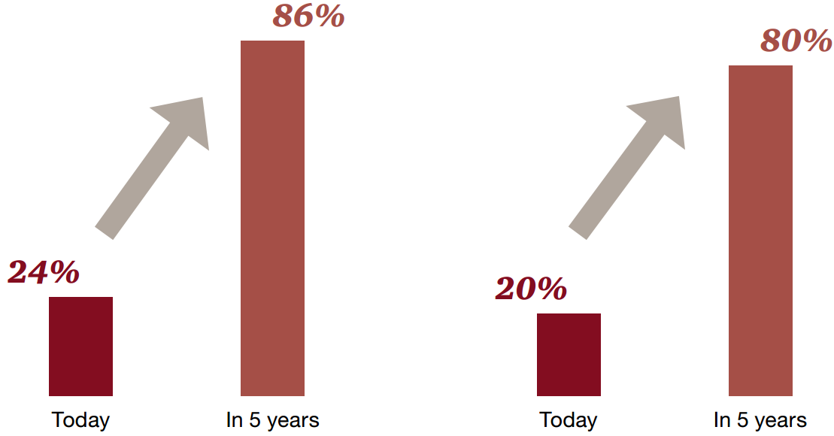
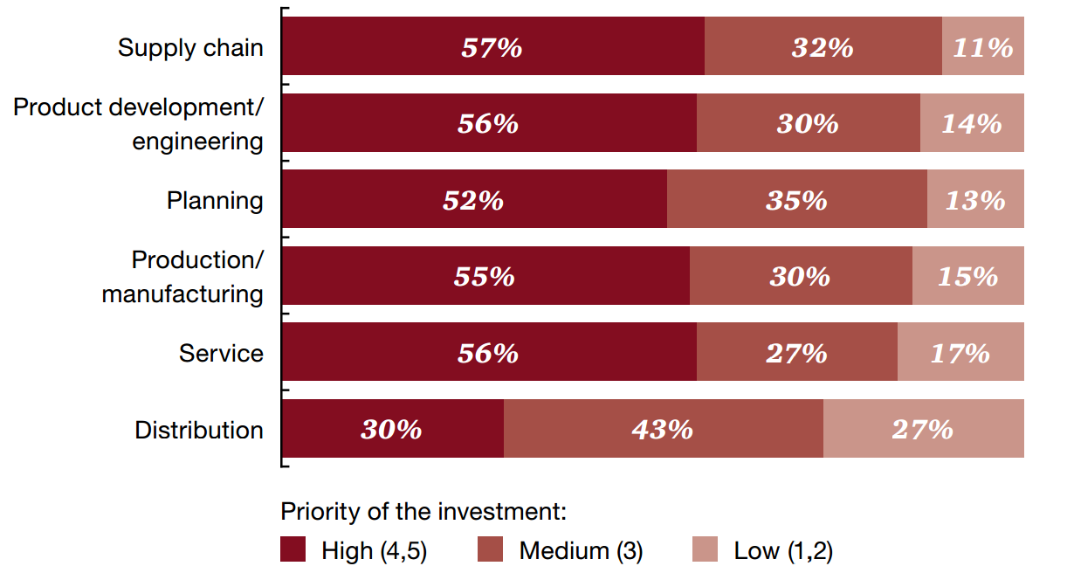
Results of a study on Industry 4.0 – Opportunities and Challenges of the Industrial Internet, based on a survey of 235 German industrial companies by the market research institution TNS Emnid.
Horizontal value chain
Vertical value chain
Degree of digitization of the value chain
Industry 4.0 investments broken down by steps of the value chain

Slide 16
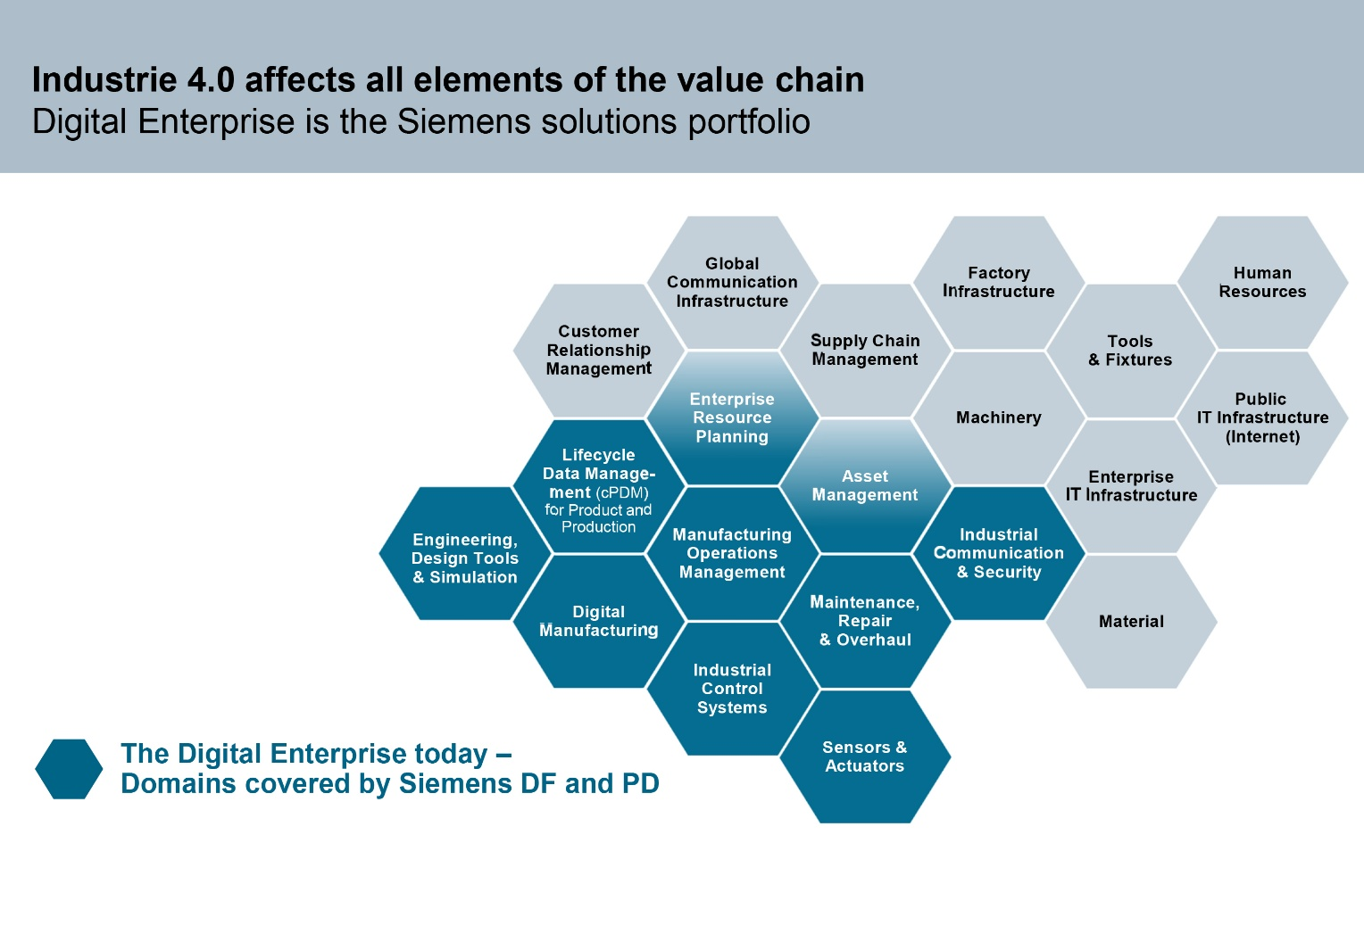
Source: Klaus Helmrich, Member of the Managing Board of Siemens AG, Hannover Messe 2015

Slide 17
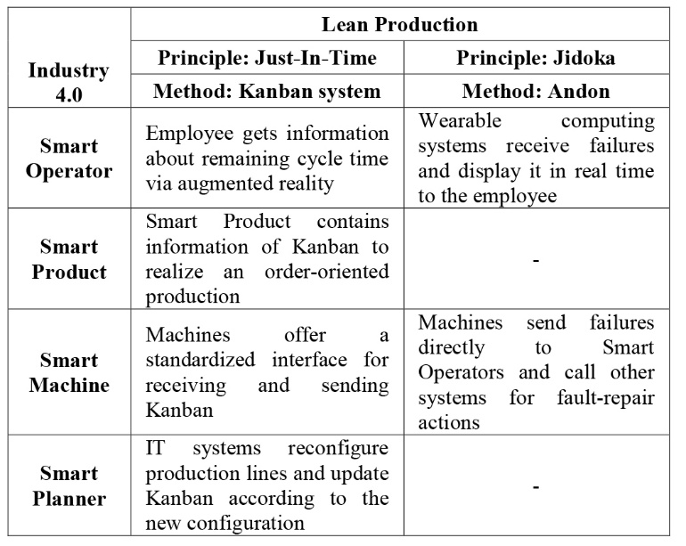
An example of use case in combining industry 4.0 with lean production
Source: Kolberg, D., & Zühlke, D. (2015). Lean automation enabled by industry 4.0 technologies. IFAC-PapersOnLine, 48(3), 1870-1875.

Slide 18


From the perspective of Bosch and its customers, we emphasize the great significance of Industry 4.0 applications for the entire industry of producing companies, including logistics departments.
Bosch is the leading consumer of Industry 4.0 applications with more than 260 manufacturing plants worldwide.
The great potential of Industry 4.0 lies in data and particularly in the efficient use of newly gained opportunities.
Analysis algorithms and refined policies for large data volumes help to selectively realize applications that are tailored to the respective needs of the end customers.
We must focus on automation. Both simple and complex business processes can be initiated and monitored with the new applications: from simple notifications by e-mail, text message or app to automatically initiated ordering of spare parts and monitoring of maintenance orders.
Dr Daniel Hug
Bosch Software Innovations GmbH,
Head of Vertical Industry & Logistics

Slide 19

What will come next?

